Slide 1
Tallinn
May 31, 2016
Notes:
Introduction to OGP

Slide 2
Five Year Anniversary
Notes:
This is great timing for this event; moment for OGP to reflect and consider where we are going in the next years

Slide 3
69 Participating Governments
1000s
of Civil Society Organizations
+2500 Commitments
110
National Action Plans

Slide 4
50 New Action Plans in 2016

Slide 5
Launching Consultations; Supporting Co-creation
Notes:
Consultation: Sri Lanka example

Slide 6
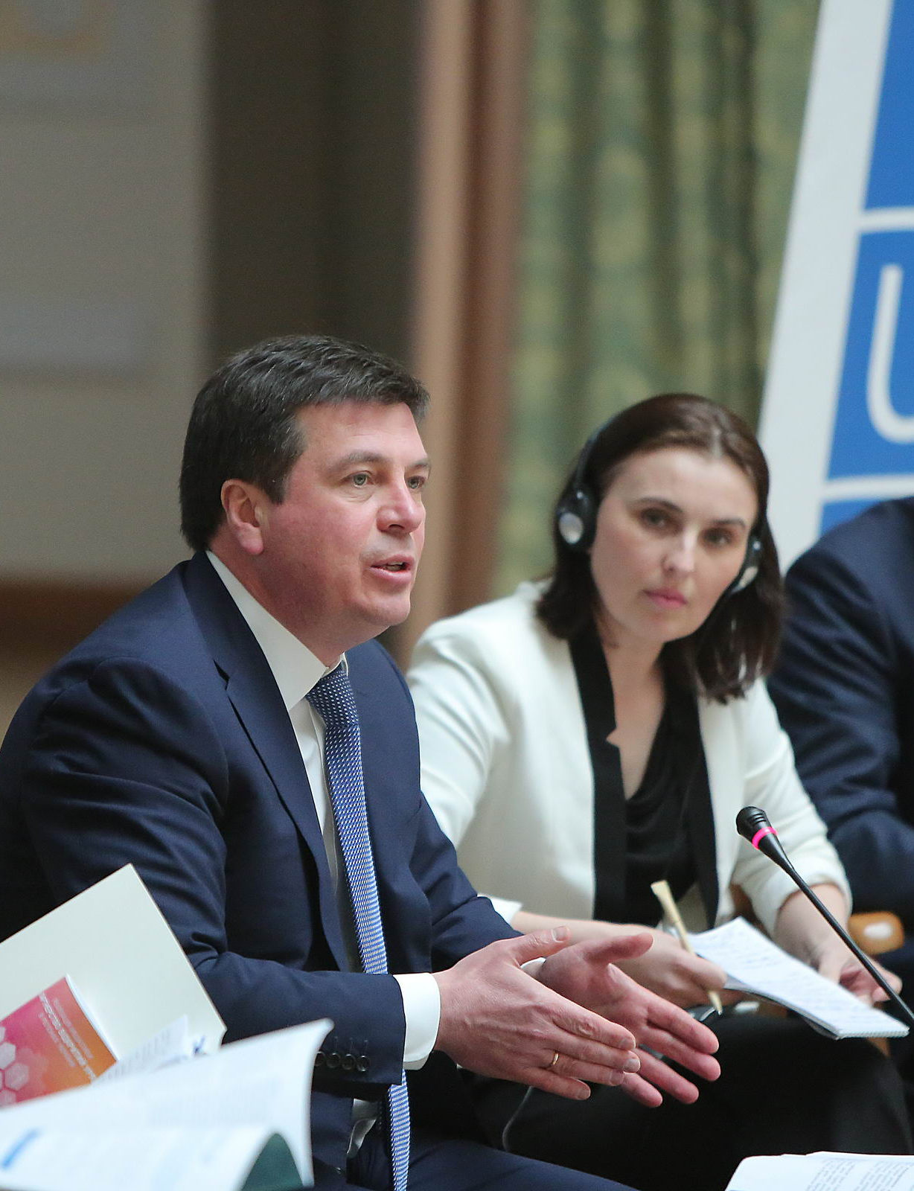
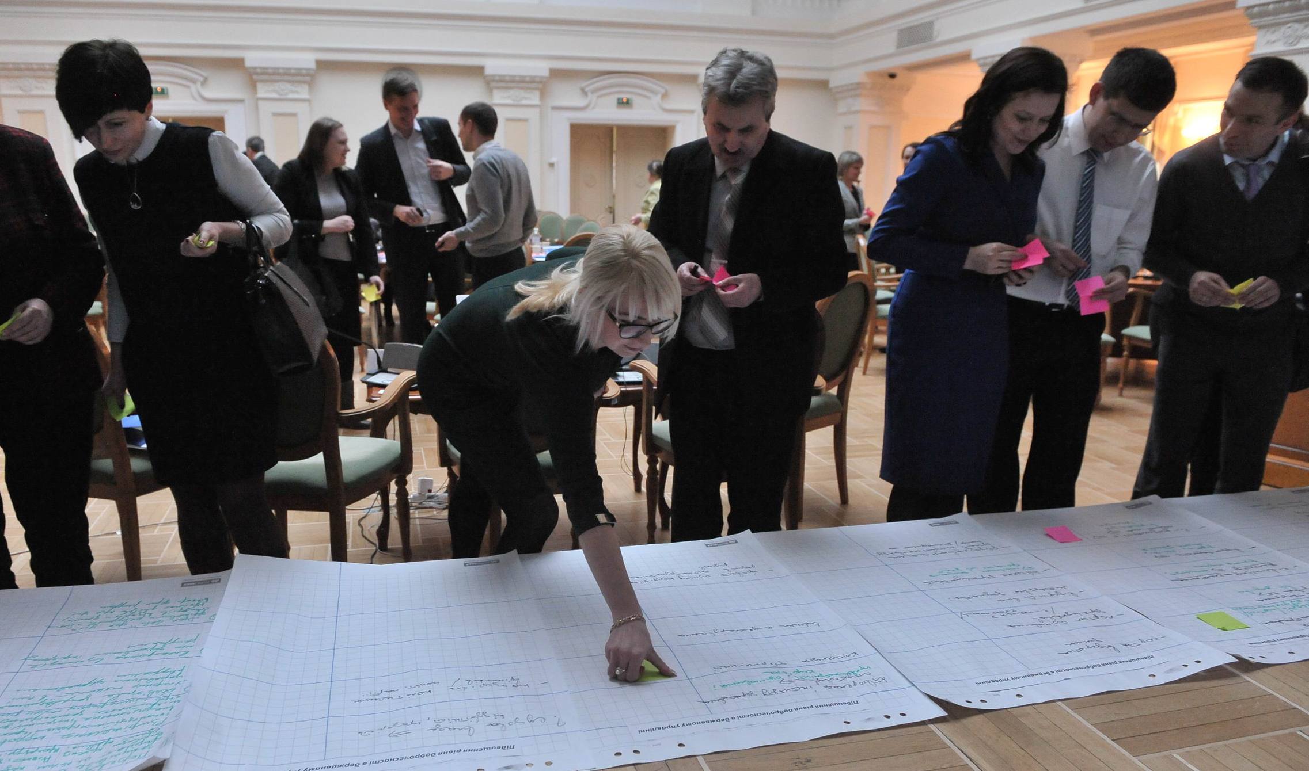
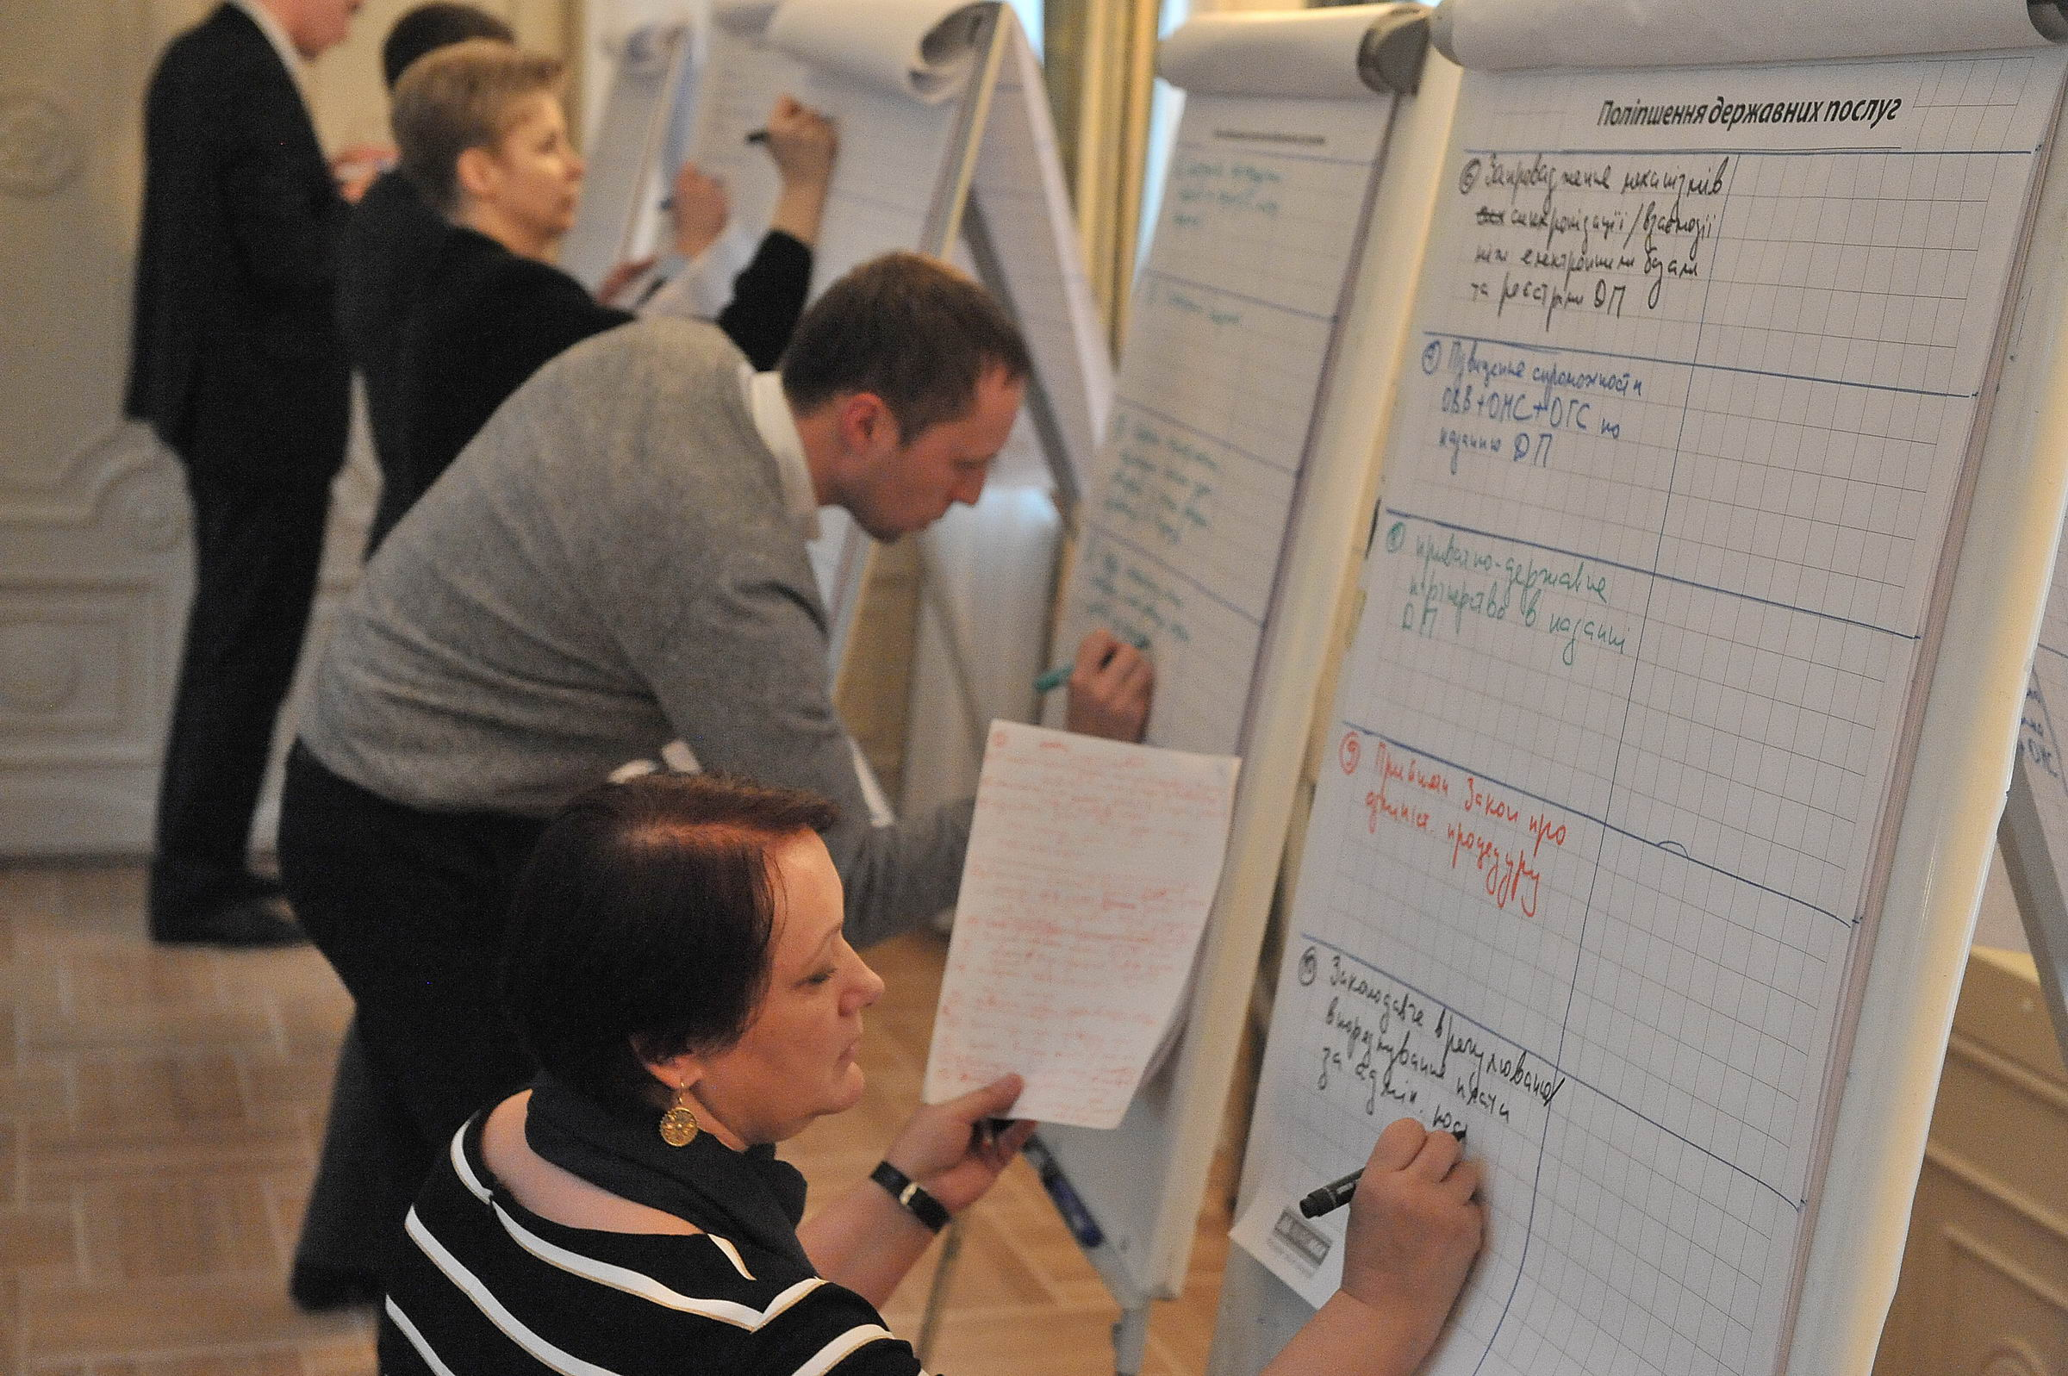
Independent Reporting Mechanism Launches
Notes:
IRM launches

Slide 7
Unlocking Soviet Archives
Notes:
Ukraine’s archives of the former secret police agency (the KGB) under the Soviet Union were under seal since the end of communism in the early 1990s.
The KGB had a significant impact on Ukraine for the entirety of the communist period and have records of their phone surveillance and missing persons that could be useful to Ukrainian citizens looking for missing family members.
Records had been under the authority of the Ministry of Justice since the end of Communism.
This is Volodymyr Viatrovich, formerly a campaigner to release these archives and now the Director of the Institute for National Memory in Ukraine.
In their last OGP action plan, the Ukrainian government set an ambitious goal to draft a law, in cooperation with civil society, allowing the opening up of communist-era archives, which were closed for decades. In the beginning of April 2015, the government submitted the draft law to the parliament and it was adopted in a few days. The law mandates that security and law enforcement agencies transfer relevant historical files to a special state archive to be set up by the Institute for National Memory. The archive will cover information about the struggle for Ukraine’s independence in the 20th century, political persecutions and human rights violations carried out by Soviet repressive bodies, World War II events, and technological catastrophes.
The Institute now has unhindered access to this information and they will begin to allow public examination of documented crimes of the KGB. This reflects a significant break from the totalitarian past of Ukraine, and enforces the right to truth.

Slide 8
Managing Mongolia’s Natural Resources
Notes:
Mongolia has one of the largest natural resource concentrations in the world (between $1 and $3 trillion in mineral wealth are estimated to be in Mongolia’s mines). The worldwide commodities boom in the previous decade helped Mongolia’s economy grow tenfold between 2002 and 2015 and rise to an upper-middle income economy. However, the wealth increase in the country did not benefit all Mongolians and many of the mining agreements were with foreign companies and conducted in secret. Often, the local community had no say in the development of mines that effected their area and in more than one case local religious sites were disturbed by mines. Many government officials were found to have taken bribes to approve mining contracts and none of the agreements were publicly available.
In the debate over a pending agreement with a foreign mining company to develop one of the world’s largest mines, the Oyu Tolgoi mine in Southern Mongolia, NGOs, citizens, the media and others complained about the lack of information available the agreement. That conversation helped spark demand for more environmental information on other environmental resources like water quality, air quality, vegetation and soil quality.
In its first OGP action plan, Mongolia committed to requiring all government agencies to release environmental information to a centrally coordinated database which is available at eic.mn. This effort was led by the Minister of the Environment in Mongolia (pictured above), who had long campaigned both inside and outside government to improving mining and natural resource transparency in Mongolia and worldwide. She proudly declared that 2014 would be the year for environmental information transparency. The EIC now contains 22 databases including information about the Oyu Tolgoi mine.
The government still needs to finish releasing information about other mines and oil extraction but has made substantial progress on this commitment.

Slide 9
Subnational Pilot
Notes:
Overview of subnational pilot

Slide 10
Austin, United States Bojonegoro, Indonesia Buenos Aires, Argentina Elgeyo Marakwet, Kenya Jalisco, Mexico Kigoma, Tanzania La Libertad, Peru Madrid, Spain Ontario, Canada Paris, France Sao Paulo, Brazil Scotland, United Kingdom Sekondi-Takoradi, Ghana Seoul, South Korea Tbilisi, Georgia

Slide 11
Peer Exchange Networks
Notes:
5 Sub-regional peer exchange networks

Slide 12
Paris Global Summit
Notes:
Looking forward to Paris Global Summit 7-9 December. Call for proposals open!

Slide 13
Next Five Years: Addressing Challenges and Deepening Impact
Greece, Tunisia,
Notes:
Where do we see the Open Government Partnership in 5 years time?
We’ve expanded enormously in the past five years, helped to bring together a global community of open government reformers and put in place a number of impressive reforms.
However:
Implementation challenges – making sure that commitments are followed through (many reasons why, lack of budget, political support, changes in government, crises)
Strengthening commitments – increasing specificity, ambition
Civil society space closing in a number of countries, really challenging for OGP as this is the philosophy of the partnership
Focusing on these areas to deepen the impact of OGP

Slide 14
Closing the Feedback Loop
Notes:
Deepening citizen engagement: Philippines example of citizen audits of government projects.

Slide 15
Leveraging Thematic Leadership
Anti-Corruption
Open Budgets
Digital Governance
Open Contracting
Climate
Notes:
Scaling up ambition: Panama papers example- anticorruption and beneficial ownership
UK anti-corruption
Climate – Paris?
Open budgets

Slide 16
Tallinn
May 31, 2016
Notes:
Brief intro to OGP

